Slide 1
Week 03 What have I learned Jiri Vana

Slide 2
NOTHING

Slide 3
Thank You
EXCEPTION UNHANDLED

Slide 4
Project analysis slide 2
WeekThree
FILE MANIPULATION
EXCEPTIONS
C#
ReadAllLines()
ReadAllText()
WriteAllLines()
WriteAllText()
…etc.
try
catch
throw
finally
…etc.

Slide 5
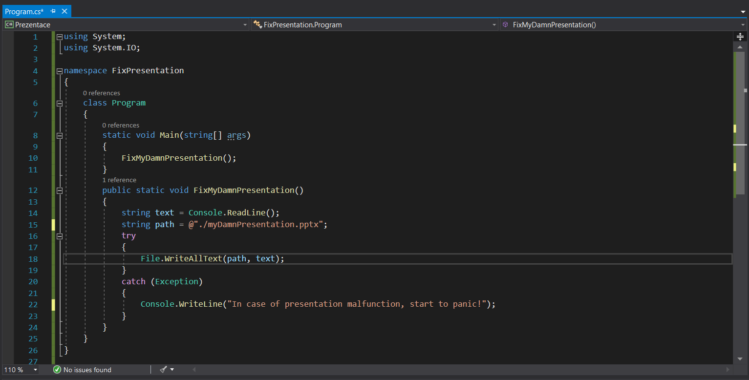
Simple file manipulation
Exceptions

Slide 6
Project analysis slide 5
SmartMeter

Slide 7
CLASSES
FIELDS
ENCAPSULATION
PROPERTIES
CONSTRUCTOR
CLASSES
DATA STRUCTURE

Slide 8
Project analysis slide 2
class WeekThree
ENCAPSULATION
CLASSES
C#
DATA STRUCTURE
FIELDS
PROPERTIES
CONSTRUCTOR

Slide 9
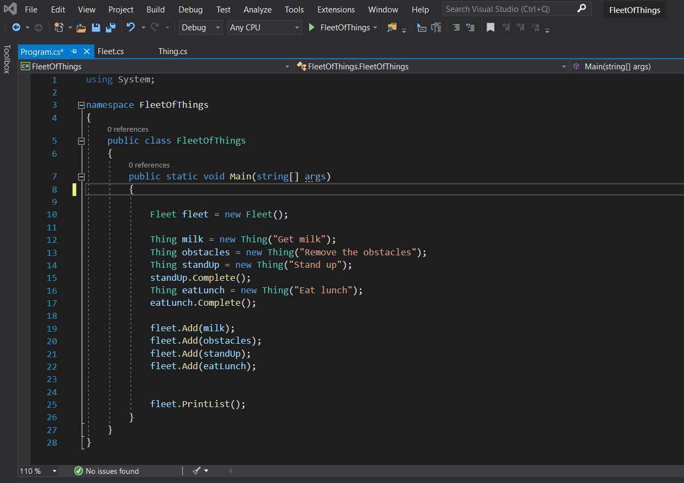
1. Create the things
2. Add them into the list

Slide 10
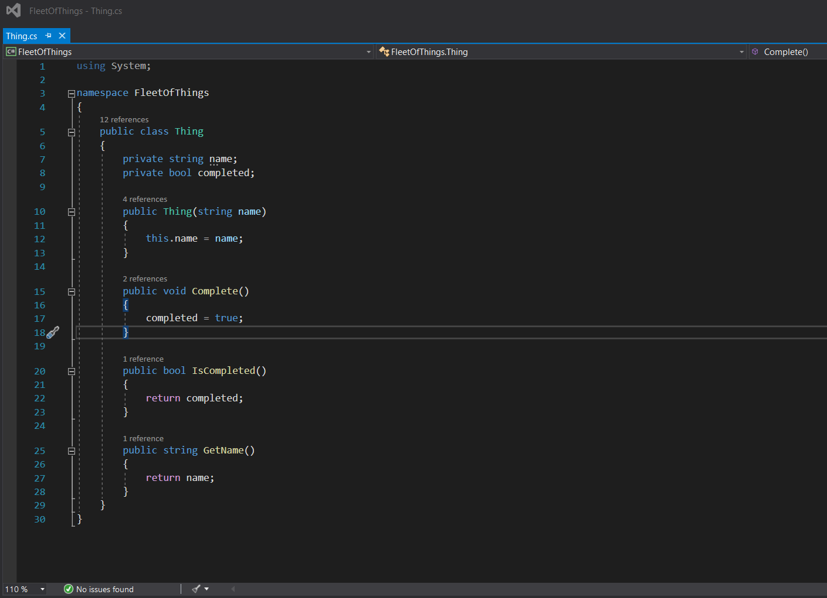
3. Create IsCompleted method
4. Create GetName method

Slide 11
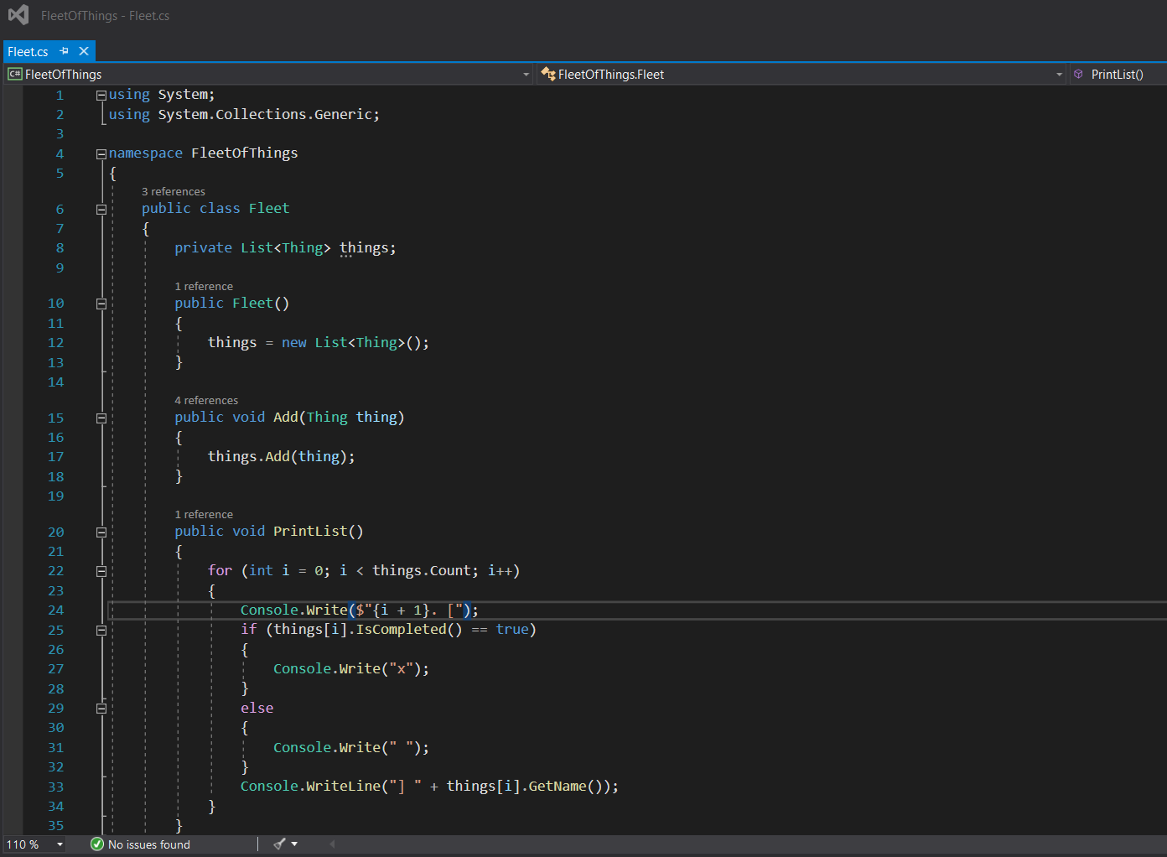
5. Create PrintList method
DONE

Slide 12
Project analysis slide 5
class SmartMeter
On the bright side – I didn’t know any of this just a few days ago

Slide 13
Thank You (for real)

